Slide 1

FDI Analysis in India

Slide 2
Problem Statement
Investment is a game of understanding historic data of investment objects under different events but it is still a game of chances to minimize the risk we apply analytics to find the equilibrium investment. To understand the Foreign direct investment in India for the last 17 years from 2000-01 to 2016-17. This dataset contains sector and financial year-wise data of FDI in India Sector-wise investment analysis Year-wise investment analysis. Find key metrics and factors and show the meaningful relationships between attributes. Do your own research and come up with your findings

Slide 3
Insights
Power BI Dashboard and Jupyter Notebook Bar Graphs Analysis
Sectors invest differently each financial year.
High-investment sectors: Banking & Insurance, Computer Software & Hardware Components.
Low-investment sectors: Computer Software & Hardware Components.
Some sectors invest more than others.
Future slides will highlight sectors with zero investment.
Forecasting methods used to identify future growth.

Slide 4
Sectors with Zero Investment in the Financial years
Sectors | Financial Years
Agriculture machinery | 2004-05
Airport Transport | 2000-01 & 2001-02
Boilers and Steam Generating Plants | 2000-01, 2001-02, 2002-03, 2005-06 & 2008-09
Cement and Gypsum Products | 2004-05
Coal Production | 2000-01 to 2016-17 except 2003-04, 2005-06, 2006-07, 2007-08, 2008-09 & 2013-14
Coir | 2000-01, 2001-02, 2002-03, 2003-04, 2008-09, 2015-16 & 2016-17
Construction | 2000-01, 2001-02, 2002-03, 2003-04 & 2004-05

Slide 5
Sectors with Zero Investment in the Financial years
Sectors | Financial Years
Defence Industries | 2000-01, 2001-02, 2002-03, 2003-04, 2005-06 to 2010-11 & 2016-17
Dye Stuffs | 2002-03, 2005-06, 2006-07, 2012-13 & 2013-14
Earth-Moving Machinery | 2000-01
Education | 2000-01, 2001-02 & 2002-03
Fertilizers | 2000-01 & 2001-02
Glue and Gelatin | 2000-01, 2001-02, 2002-03, 2003-04, 2004-05, 2005-06, 2006-07, 2008-09 & 2012-13
Hospital and Diagnostic Centers | 2000-01

Slide 6
Sectors with Zero Investment in the Financial years
Sectors | Financial Years
Industrial Instruments | 2006-07
Mathematical, Surveying and Drawing Instruments | 2000-01 to 2016-17 except 2007-08 & 2012-13
Non-Conventional Energy | 2000-01 & 2001-02
Printing of Books (including Litho Printing Industry) | 2000-01, 2001-02 & 2003-04
Railway Related Components | 2000-01 & 2001-02
Scientific Instruments | 2007-08 & 2009-10
Soaps, cosmetics & Toilet Preparations | 2000-01, 2001-02, 2002-03, 2003-04

Slide 7
Sectors with Zero Investment in the Financial years
Sectors | Financial Years
Sugar | 2000-01, 2001-02 & 2003-04
Tea and Coffee | 2002-03
Timber Products | 2000-01 & 2006-07
Vegetable Oils and Vanaspati | 2000-01, 2001-02 & 2002-03

Slide 8
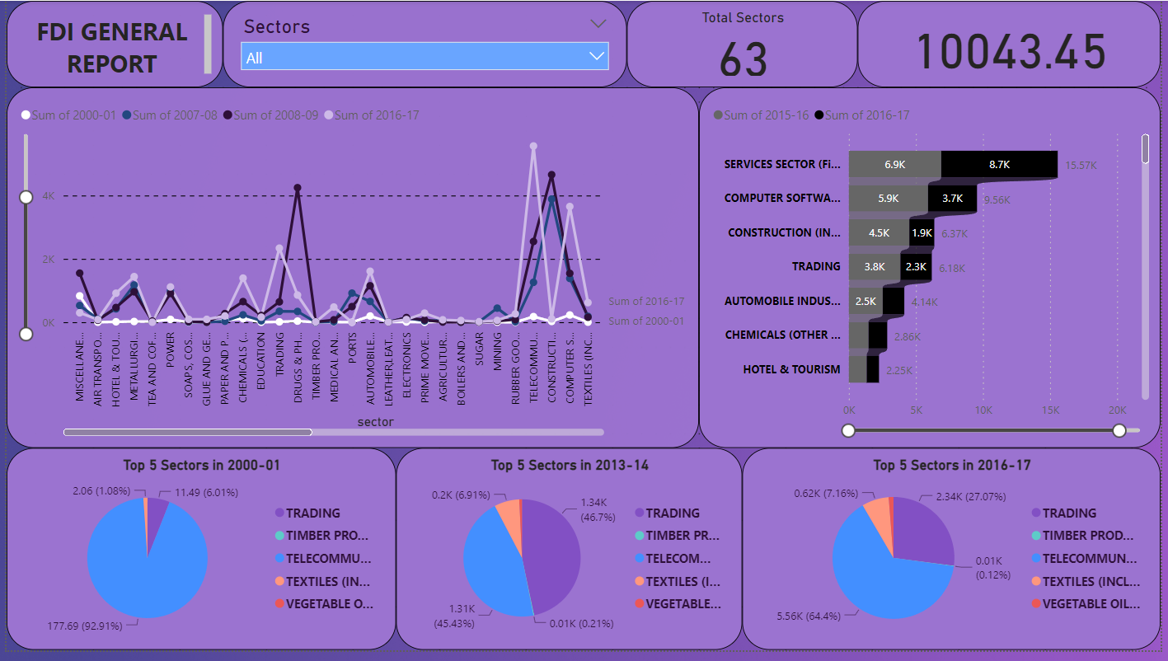
Insights(power bi)

Slide 9
InsightS(power bi)
The line chart on the left shows the sum of investments in various sectors from different time periods, specifically highlighting the years 2000-01, 2007-08, 2008-09, and 2016-17.The peak in the chart around 2016-17 indicates a significant rise in FDI, primarily driven by sectors like Services, Computer Software, and Construction.
Sector Breakdown
On the right, there's a detailed breakout for specific sectors in 2015-16 and 2016-17, illustrating a dramatic shift in the amounts invested. The Services sector appears to lead in FDI, followed by Computer Software and Construction.
Trends and Shifts
The distribution and composition of FDI have evolved, with newer sectors like Telecommunications and Textiles gaining prominence over time, likely reflecting shifts in economic focus and policy impacts.

Slide 10
RECOMMENDATIONS(POWER BI)
Recommendations
Focus on High Growth Sectors: Allocate more resources to sectors showing upward trends in FDI, such as Services, Computer Software, and Telecommunications, to capitalize on their growth potential.Diversification: Continue diversifying the sectors attracting FDI to stabilize economic growth and reduce dependence on any single sector.Policy Enhancement: Adjust policies to enhance the attractiveness of emerging sectors that are starting to draw FDI but have not yet reached their potential.

Slide 11
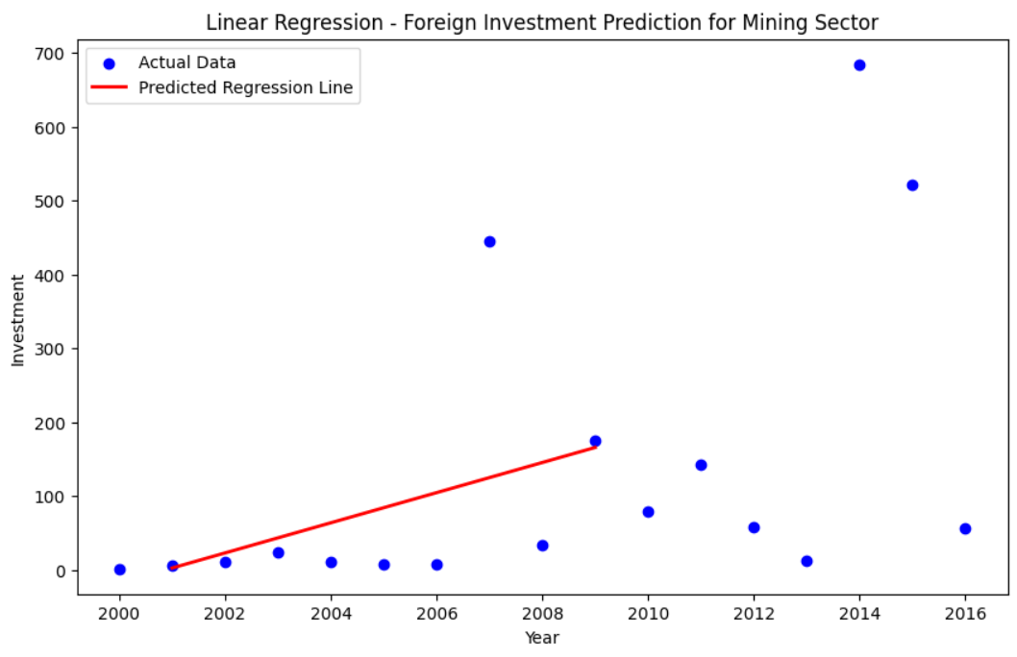
Linear Regression FOR MINING SECTOR
Linear regression is a data analysis technique that predicts the value of unknown data by using another related and known data value.

Slide 12
Linear Regression FOR MINING SECTOR
Data Points: Each blue dot represents the actual amount of investment in a particular year.The investments vary significantly over the years, with a couple of peaks possibly indicating years of high investment due to various economic or policy factors.
Recommendations:
Further Analysis: It would be beneficial to incorporate more complex models that account for cyclic trends or potential influencing factors like global commodity prices or regulatory changes to better understand and predict future investments.
Diversified Investment: Given the volatility in year-to-year investments, a diversified investment approach within the sector might mitigate risk.

Slide 13
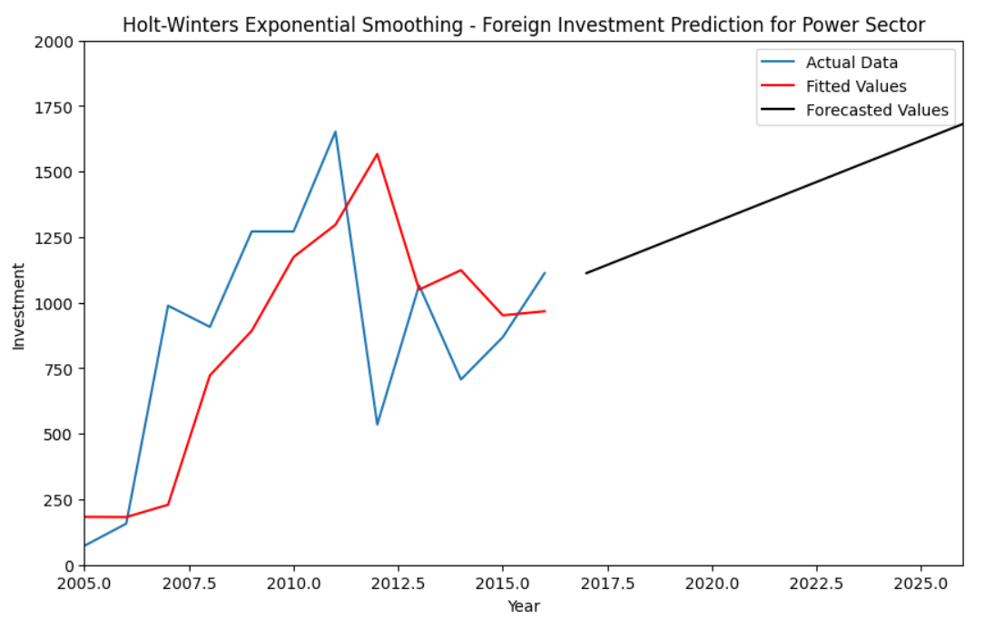
The Holt-Winters METHOD FOR POWER SECTOR
The Holt-Winters method is a seasonal forecasting technique that uses exponential smoothing to generate future values from past data.

Slide 14
The Holt-Winters METHOD FOR POWER SECTOR
The graph shows foreign investment in the power sector from 2005 to 2025, using Holt-Winters Exponential Smoothing for analysis. This technique helps in forecasting data where there is a trend and seasonal pattern.
Components of the Graph:
Actual Data (Blue Line): This represents the real investment figures recorded from 2005 through approximately 2017.
Fitted Values (Red Line): These are the values estimated by the model based closely on the actual data, aiming to closely follow and smooth out the actual investment trends.
Forecasted Values (Black Line): This extends beyond the actual and fitted data, predicting future investment levels from approximately 2017 to 2025 based on the identified patterns and trends.

Slide 15
The Holt-Winters METHOD FOR POWER SECTOR
Growth Period: From 2005 to 2010, there was a significant and steady increase in investment, indicating a period of robust growth in the sector.
Volatility: Between 2010 and 2017, the investment levels show considerable volatility, with sharp increases and decreases. This could indicate economic or policy changes impacting investment levels.
Forecast Trend: The forecasted trend from 2017 to 2025 shows a gradual upward slope. This suggests that, despite past volatility, the overall investment trend in the power sector is expected to grow steadily. The model likely factors in both the growth potential of the sector and historical fluctuations.

